Slide 1

CUSTOMER PREDICTION
APRIL 2025

Slide 2
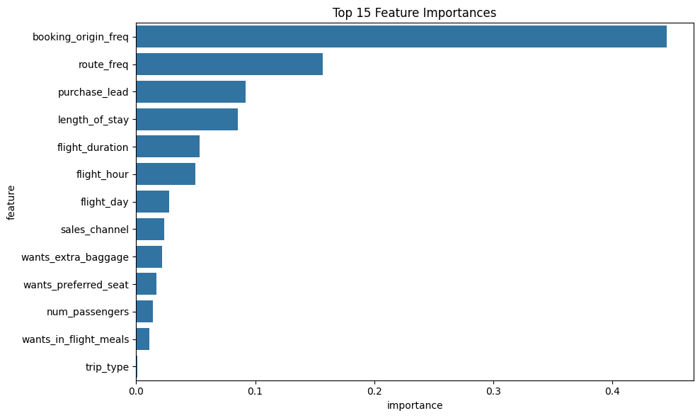
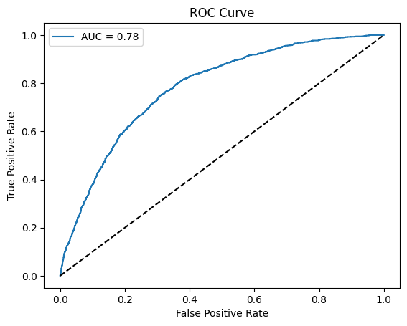
RESULTS
Evaluation
The most important feature was booking_origin_freq
followed by route_freq and purchase_lead.
Travel related features like length_of_stay and flight_duration
were also significant.
The model achieved an accuracy of 71% with a recall of 73%
for the positive class. The high recall and low precision is
acceptable if missing a booking is costlier than falsely
predicting one.
The AUC was 0.78, which indicates good model performance.
I suggest to add more customer focused features into the
model.

